Slide 1
Windows Configuration Management with Puppet
Why let the Linux admins have all the fun?
Notes:
Often it seems that all the conversations around configuration management only mention Linux.
The reality is that you can apply the same techniques to Windows and even use a single toolset across both.

Slide 2
Gene Liverman
SRE @ Puppet
Formerly SysAdmin @ University of West Georgia
Windows, Linux, Mac, & Solaris
Storage, Firewalls, Load Balancers, etc.
Notes:
I started at Puppet in April with a focus on our hardware and virtualization infrastructure
Prior to that I was a SysAdmin at a university managing servers with varying OS’s
I worked in AD regularly and managed our data center.
During that time I ran Puppet Open Source in production for about 2 ½.
As a quick note, my contact info and a link to this presentation will be on the last slide.

Slide 3
Agenda
Better together
Chocolatey
Patching
Modules
Packer
Notes:
This talk is an introduction to why you might want to use Puppet in a Windows environment.
It’s broken up into a few categories that cover the aspects I’ve found most useful over the last few years

Slide 4
Better Together
(DSC, Hyper-V, SCCM, WMI) + Puppet
Notes:
Puppet can supplement the tools you may already be using.
Taking a ”better together” approach means there’s less of a learning curve and you get the best of both worlds.

Slide 5
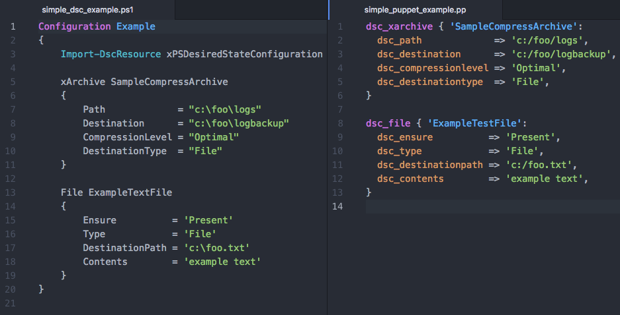
DSC in PowerShell vs DSC via Puppet
Write less code to do the same thing
Notes:
Many Windows admins are using PowerShell’s Desired State Config to make their lives easier.
Puppet fully supports DSC and has a very similar syntax which makes switching between the two relatively easy.
This example shows how you can translate DSC resources into Puppet resources.
In addition to the syntax being very similar, note that the boilerplate isn't needed and there are fewer lines of code in the Puppet version.

Slide 6
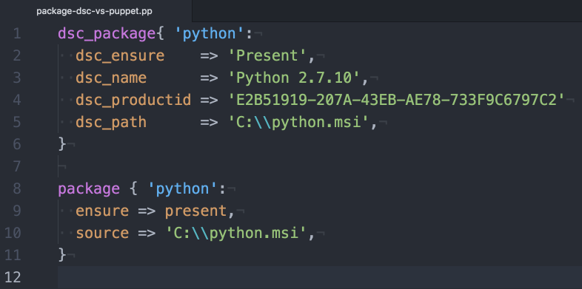
Migrate resources to Puppet
Get the same result fewer lines of code
Notes:
There’s nothing wrong with just doing a 1:1 translation of DSC to Puppet like what was just shown.
That said, there are some advantages to native Puppet over DSC alone.
Package installation is one of those things.
Both of these resources do the same thing but the native Puppet one is much simpler to write and maintain.
In particular, Puppet doesn’t require you to know the product ID which means you don’t have to hunt it down before writing or updating your code.

Slide 7
Puppet + DSC
DSC doesn’t do everything Puppet does
No real reporting
No rebooting as needed
No package management
Doesn’t keep historical data on changes performed
DSC does cover things Puppet doesn’t
Hyper-V is one example
Notes:
DSC and Puppet each have their pros and cons just like everything else.
Foe example:
DSC reporting is basically hunting through event logs.
Anyone who’s worked with Windows knows that installing things generally means a reboot is needed yet DSC doesn’t provide a graceful way to handle this.
DSC lets you install MSI’s but stops way short of really managing your packages.
All that said, there are things that DSC does that Puppet doesn’t. Hyper-V is a prime example of this.

Slide 8
Puppet, DSC, & Hyper-V
xVHD: VHDs
xVhdFile: files or directories in a VHD
xVMDvdDrive: DVD drives attached to a VM
xVMHost: Hyper-V host settings
xVMNetworkAdapter: VMNetadapters on a VM or the management OS
xVMProcessor: VM processor options
xVMSwitch: virtual switches
The xHyper-V module
Notes:
DSC provides a wealth of resources for managing Hyper-V. The bullets on this slide represent all the resources defined in the xHyper-V PowerShell module.
Combining these with Puppet allows you to manage as little or as much of your Hyper-V environment as you desire right along side the servers being deployed into it.

Slide 9

You'll likely run into a situation where either Puppet or DSC doesn't cover the entirety of the problem all by itself. Instead of trying to make one solution fit all, you can mix and match them.
Paraphrasing the “Managing Windows with Puppet Enterprise” white paper
Notes:
If you work with either of these tools, you'll likely run into a situation where either Puppet or DSC doesn't cover the entirety of the problem all by itself.
Instead of trying to make one solution fit all, you can mix and match them.
(example on next slide)

Slide 10
Puppet, DSC, & Hyper-V
Typical network: VM → virtual switch → physical switch(s)
VM: DSC’s xVMNetworkAdapter
virtual switch: DSC’s xVMSwitch
physical switch(s): Puppet modules for Arista, Cisco, Cumulus, Juniper
End-to-end network management
Notes:
One example of mixing and matching could be the network layer of your Hyper-V environment.
A typical network setup has a vm connected to a virtual switch which, in turn, is connected to a physical switch.
- DSC provides a means of managing all the virtual components.
- Puppet provides a way of managing many physical switches including ones from Arista, Cisco, Cumulus, and Juniper.
- By putting your DSC code in Puppet you can manage the entire setup in one place

Slide 11
Layering Puppet Enterprise on top of DSC
Gain rich management capabilities including:
Node classification
Status of nodes across your infrastructure
Global access control
Authentication can be via AD credentials
Tracking and reporting change
This simplifies compliance auditing
Notes:
Taking the better together idea a step further, you can gain some rich management capabilities by layering Puppet Enterprise on top of DSC.
These capabilities include:
- node classification
- being able to see the status of nodes across your infrastructure
- global access controls that tie back to AD
- and centralized tracking and reporting of changes.

Slide 12
Puppet Facts
Facts are pieces of info about each system puppet runs on such as
IP address
MAC address
host name
OS
Facts can be used as variables in Puppet manifests
Custom facts can integrate with external systems
Notes:
Facts are pieces of info about each system puppet runs on such as IP address, MAC address, host name, and OS.
Since facts can be used as variables in Puppet manifests it can be useful to create custom ones specific to your needs.
In addition to things that can be discovered about a server or switch by interrogating it, custom facts allow you to leverage info stored in systems outside of Puppet such as Systems Center.

Slide 13
Puppet + WMI
Integrate with existing SCCM
Query client configuration such as location
Starting out with Puppet custom facts
https://glennsarti.github.io/blog/puppet-ruby-facts/
Module: thoward/sccm_application
Installs or uninstalls packages advertised by SCCM
Notes:
An example of this would be querying SCCM for the location of a server and using that as part of a decision-making process in your Puppet code.
There is a great walk through for getting started with custom facts written by one of our Windows developers that I recommend checking out later.
Facts are not the only integration point either.
A community member named Trevor Howard wrote a module that installs or uninstalls packages advertised by SCCM.

Slide 14
Chocolatey
aka apt-get / yum for Windows
Notes:
I like to think of Chocolatey as apt-get or yum for Windows

Slide 15
Package management for Windows
What is Chocolatey?
Builds on NuGet
Provider for PackageManagement (aka OneGet) in WMF 5
Public repo: chocolatey.org
Private repo: Chocolatey Server
Great for internal software packages
Module: chocolatey/chocolatey_server
Notes:
Chocolatey is a Windows package manager that can be used to manage third-party and internal software.
Chocolatey builds on NuGet to provide an easy-to-use interface for users and admins
PowerShell 5 can use even Chocolatey as a provider for the PackageManagement module.
Publicly available packages can be browsed and installed from chocolatey.org
You can also run your own NuGet server to distribute internal software
There is even a Puppet module that makes it super easy to setup a NuGet server if you don’t already have one

Slide 16
Common use cases for Chocolatey
FOSS Puppet agent
Monitoring & Backup agents
Log shipping
PowerShell / WMF, .Net, NodeJS
Browsers & plugins
Chrome & Firefox
Adobe, Flash, Java
Utilities such as Git, 7-Zip, & Notepad++
Notes:
This is just an example of some of the many things that can be installed from chocolatey.org
(pause for a few beats)

Slide 17
Patching
WSUS + strict change windows + Puppet
Notes:
Now, let's shift gears a little and talk about everyone's favorite task: patching.
Many Windows shops find that WSUS alone doesn’t allow them to fully automate the process due to variations in how or when things get installed.
This is especially true if you have strict change windows in which patches must be applied.
Lets take a look at how Puppet can help with that.

Slide 18
Patching scenario
Define a maintenance window
Configure automated reboots
Configure WSUS-related settings
Install & manage Chocolatey
Install / upgrade PowerShell
Install NuGet package provider for PowerShell
Install PSWindowsUpdate PowerShell module
Pre-download updates
Apply all non-interactive updates
Notes:
In a moment we're going to look at some Puppet code that can help automate the patching process. The code will implement the scenario outlined here.
(pause for a moment)

Slide 19
Demo Time: Code Sample
A Puppet manifest for patching Windows
Notes:
(walk through win_patching.pp in Atom)
(video on next slide)

Slide 20
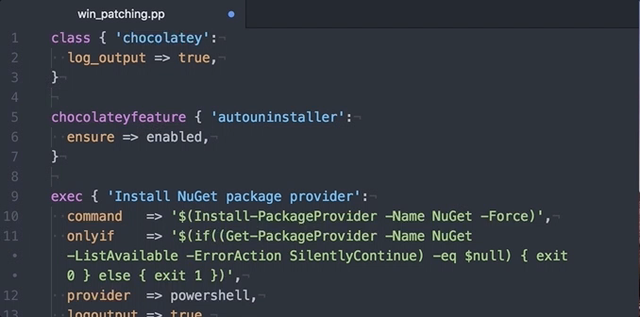
Code sample (video)

Slide 21
Modules
Common tasks made easier and repeatable
Notes:
You’ve heard me mention modules a few times already so lets take a look at what they are and how they can help you.

Slide 22

Puppet Modules
Modules are self-contained bundles of code and data. These reusable, shareable units of Puppet code are a basic building block for Puppet.
https://forge.puppet.com
Notes:
Puppet modules are basically reusable and sharable chunks of Puppet code.
The Puppet Forge is where most modules are shared and acts as a central repository.

Slide 23
Module: puppetlabs/windows
This module acts as a pack of the Puppet Forge's best Windows content.
Vox Pupuli, voxpupuli.org
puppet/download_file
puppet/windows_env
puppet/windowsfeature
Puppet, puppet.com
puppetlabs/acl
puppetlabs/chocolatey
puppetlabs/dsc
puppetlabs/iis
puppetlabs/powershell
puppetlabs/reboot
puppetlabs/registry
puppetlabs/stdlib
puppetlabs/wsus_client
Notes:
Installing the puppetlabs-windows module will pull in all the modules listed here.
These modules are listed on the Forge under two authors' names:
- Puppet Labs, which is what our company name used to be,
- and puppet, which is Vox Pupuli.
The latter is a collective of 30 module, tooling, and documentation authors who are currently working together to maintain 131 different repositories.

Slide 24
Modules for common Windows tasks
A sample of what’s on the Puppet Forge
Backups:
thespain/veeamagent (WIP)
FOSS Puppet:
theforeman/puppet
Logs:
genebean/nxlog
puppet/windows_eventlog
Monitoring:
genebean/zabbixagent
icinga/icinga2
puppet/nsclient
sensu/sensu
Others:
puppet/sslcertificate
puppet/windows_firewall
puppetlabs/azure
puppetlabs/aws
Notes:
This list is just a sample of some of the modules on the Forge for managing common tasks on Windows boxes.
- veeamagent is being written by a friend of mine and will soon be on the forge.
- The Foreman project's puppet module is a great way to manage the open source Puppet agent.
- my nxlog module is designed to help ship logs to a central server
- windows_eventlog manages the size, rotation, and retention of each event log
- my zabbixagent module along with the icinga2, nsclient, and sensu modules can help you configure monitoring
- sslcertificate installs and removes certificates on Windows machines
- windows_firewall helps you manage host-based firewalls much like the puppetlabs firewall module does on Linux
- azure and aws help you manage your cloud resources

Slide 25
But there’s not a module for X
Now what?
Notes:
But what if you need to configure something that there is not a module for and that you can’t cover with DSC?

Slide 26
Puppet Development Kit
The shortest path to better modules
Notes:
That’s where the new Puppet Development Kit comes in.

Slide 27
Puppet Development Kit
Takes care of environment setup
Generates all files needed
Reduces the learning curve
Helps you get something useful faster
Why us the PDK?
Notes:
The PDK takes care of setting up everything needed to write and test a Puppet module. This includes installing ruby and hiding bundler so that you don’t have to deal with it.
The pdk command makes it easy to generate all the different parts of a module
This makes it much easier to get started and greatly reduces the learning curve which means you can make something useful in much less time than doing everything by hand.

Slide 28
Where do I get the PDK?
Currently in preview
https://github.com/puppetlabs/pdk
1.0 coming soon
Notes:
Right now the PDK is in preview.
All the code is on GitHub along with a link to download binary installers.
The current version is zero dot five but we expect to be up to 1.0 soon

Slide 29
Packer
Templated virtual machines
Notes:
When writing and testing code its helpful, and sometimes necessary, to have a sample of the target operating system.
Packer lets you define what those sample machines look like in a concise way and then build them for use on a variety of platforms including local and remote virtualization environments and cloud providers.

Slide 30
Packer resources
Blogs:
http://www.hurryupandwait.io/blog/creating-windows-base-images-for-virtualbox-and-hyper-v-using-packer-boxstarter-and-vagrant
Templates:
https://github.com/puppetlabs/puppetlabs-packer
https://github.com/mwrock/packer-templates
Packer: https://www.packer.io
Notes:
If you do any automated testing and are not already using Packer then I'd highly recommend checking it out.
If you want to get started with Packerized Windows boxes then you should read this blog post from Matt Wrock.
You can also find some sample templates in these two repositories to give you an idea of how you might want to set yours up.

Slide 31
What we talked about
DSC, WMI, SCCM
Package management with Chocolatey
Patching and rebooting during change windows
Managing common tasks with Puppet modules
Building images with Packer
Notes:
To wrap up, we talked about :
- DSC, WMI, and SCCM and how you can integrate them with Puppet
- Package management with Chocolatey
- Patching and rebooting during change windows
- Managing common tasks with the help of modules from the Puppet Forge
- and building images using Packer

Slide 32
References and resources
Blog posts on Windows from Puppet:
https://puppet.com/blog-tags/powershell-dsc
https://puppet.com/blog-tags/windows
Blog post on custom facts: https://glennsarti.github.io/blog/puppet-ruby-facts/
Chocolatey: https://chocolatey.org
PackageManagement (aka OneGet): https://github.com/OneGet/oneget
PowerShell xHyper-V: https://github.com/PowerShell/xHyper-V
Puppet Forge: https://forge.puppet.com
White paper:
https://puppet.com/resources/whitepaper/managing-windows-with-puppet-enterprise
Notes:
This slide provides some resources to help you get started with Puppet on Windows plus some references for things I mentioned earlier.

Slide 33
Puppet Community
Hang out with other Puppet users and get help when you’re stuck:
Slack: http://slack.puppet.com
Q&A: http://ask.puppet.com
IRC: #puppet or #puppet-dev on Freenode
Google group: http://groups.google.com/group/puppet-users
Puppet User Groups (PUGs): https://puppet.com/community/user-groups
https://puppet.com/community
Notes:
Puppet also has a vibrant community. We have a variety of ways for you to hang out with other Puppet users and to get help when you're stuck. We've got everything from traditional email and IRC to a Q&A site to Slack. We also have Puppet User Groups all over the place and even a virtual one. Check out one of these sites or visit our community page for even more options.

Slide 34
Go have some fun automating your Windows configurations
Let Puppet do the repetitive things while you play with new stuff
Notes:
Now, go have some fun automating your Windows configs. Once you do you can let Puppet do all the repetitive stuff while you play with new things.

Slide 35
Gene Liverman
gene.liverman@puppet.com
genebean.github.io/talks
github.com/genebean
@technicalissues
Notes:
Feel free to reach out if you have any questions
The GitHub pages site linked here is where you can find a copy of this presentation.

